Slide 1
Speech Based Servant Bot
09005044 Dhiraj Ganji
09005048 Girish Chintapalli
09005051 Gaurav Torka
09005057 Sai Teja Pratap

Slide 2
Project Description
The goal of the project is to control a the firebird robot by specifying speech commands to an Android phone.
We demonstrate this by implementing a servant bot which traverses in a white line grid as per the user commands.

Slide 3
The user instructions will be as follows
Move x y : The bot moves to position(x,y) on the white line grid avoiding obstacles
Stop : The bot ignores all the previous instructions and stops at the next junction

Slide 4
Task Specifications
Incorporate speech recognization in the the Android Phone.
Establish a bluetooth connection between the firebird bot and Android phone to communicate the instructions.
Given a sequence of destinations, make the bot travel to all of them along the whiteline path.
Avoid obstacles along the path as the bot moves towards its destinations.

Slide 5
Project Plan
March 20: Bot work without obstacle avoidance, make the speech working on Android
March 29 : Complete bot work excluding Bluetooth, learning about how to work with bluetooth on Android and on Firebird
April 9 : Complete working on bluetooth and integrate everything
April 11: Complete testing and removing minor bugs in the programs
April 15: Complete documentation and edit the code to make it more readable

Slide 6
Work Division
Working on firebird Bot
Dhiraj
Sai Teja
Working on the Android part
Girish
Gaurav Torka

Slide 7
Dates of completion
March 21: Speech recognition app for Android.
March 22: Firebird programming without obstacle avoidance
April 9: Firebird programming with obstacle avoidance
April 10: Testing
April 10: Configuring the Firebird for Bluetooth.
April 10: Android App for sending message over established Bluetooth connection (not working properly)
April 18: Documentation and Final Report

Slide 8
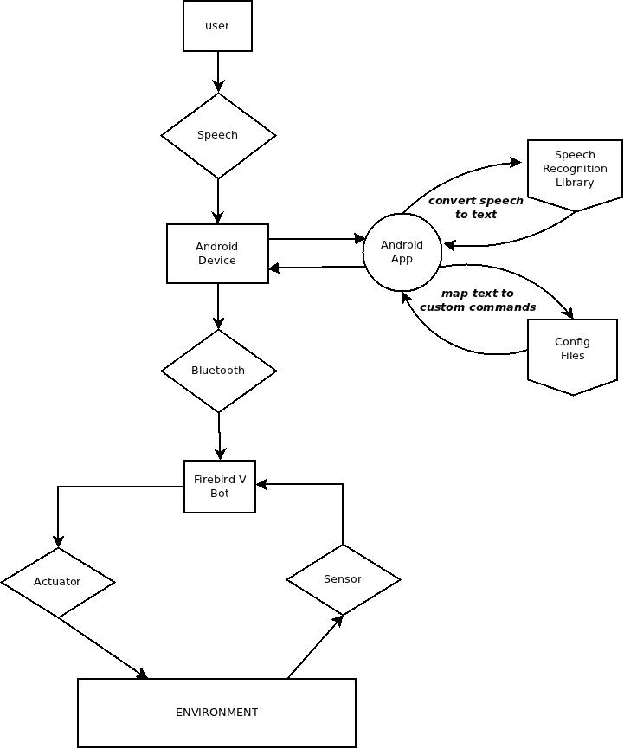
State Chart

Slide 9
Tasks Completed
Bot actions
The bot is a white line follower and decides which path to take when it sees a junction.
At a junction once it knows about which direction to turn , the problem is to make the bot rotate.
For this we rotate in the appropriate direction and wait for white line

Slide 10
Obstacle Avoidance
If there are no obstacles then the bot clears the x distance and then moves along y-axis until it reaches the destination
If there is an obstacle in path , the problem is the bot does not know which path to take among all the available
We implemented a modified version of DFS which gives good paths in very less time in most of the cases.
The edges between the nodes are updated dynamically.

Slide 11
Speech Recognition and mapping to Bot commands
On giving a speech input, the Android phone detects the speech and converts it to text
A java library called PocketSphinx is used for this.
To add new commands all one have to do is specify the mapping between text and bot commands into an xml config file.

Slide 12
What is not done?
U-cos:
We started off by working on u-cos and faced a lot of difficulties. LCD was not working and it became really difficult to debug the code.
We were unable to figure out how to use Interrupts in u-cos
Finally we decided to work on AVR-gcc
Transfer of messages over Bluetooth:
There is a problem in transmitting the messages over Bluetooth.
All messaged sent are not received correctly.

Slide 13
Testing
As the bluetooth communication is not working properly, for testing purposes we hard coded the destinations to check if everything is working fine.
The bot code works fine, avoids obstacles and reaches destination of there is a path to the destination.
The testing has been done with number of destinations upto 6 and around 10 obstacles.
The behavior of the bot was as expected.
The speech library converted the speech to correct text in around 80% of our trials.

Slide 14
Delays
Even in the presence of obstacles the computational delay of the alternative path came out to be negligible .
There is 1-2 secs delay between giving the speech intput and android and its conversion to text.
A clear picture of the system’s efficiency can be obtained only if the Bluetooth part works and is everything is tested together.

Slide 15
Re-Usablity
The code is well documented. The existence of all the functions are explained and what the function does and how it achieves that is also written in the code as comments
The code for obstacle avoidance , speech recognition can be used independently and are not bot specific.

Slide 16
Future Enhancements
The first and most important enhancement would be to make the bluetooth work.
Apart from them, the project can be used as a start point for projects planning to use Speech processing
The project can be extended to control multiple bots that are present in a remote location by a single android device and replacing the bluetooth with wireless connection.
By attaching a camera to the bot one can make the bot explore remote areas.

